Slide 1
Practical Uses of IRS Online Tools and Transcripts

Slide 2
Tax Controversy and Tax Administration
IRS Compliance: 19 years
Controversy practice and software development: since 2006
Frequent author and CPE instructor in tax controversy and post-filing best practices
Former Chair, IRS Electronic Tax Administration Advisory Committee (ETAAC)
Former NC Representative, IRS Taxpayer Advocacy Panel (TAP)
Twice honored in Accounting Today’s Top 100 Most Influential People in Accounting

Slide 3

Expectation: financial service providers have modern online tools to serve their customers.
In 2025, approximately 164M individuals and over 20M business and specialty taxpayers will file a return with the IRS.
Each year, approximately 40% of taxpayers must interact with the IRS outside of filing a tax return.
IRS is moving to a digital-first service model….adding many online features for taxpayers and tax pros.
Tax pros are more relying on IRS transcripts to help their clients with IRS issues and information. In 2024, tax pros downloaded/used over 1.47 billion transcripts.

Slide 4

Our Goals
Understand the current and future scope of IRS online tools
Know how to get access to IRS digital tools
Use IRS digital tools effectively in helping your clients
Activate filing and recording Forms 2848 and 8821 online with the IRS
Learn common needs that require working with the IRS outside of filing a tax return
Discover practical uses for IRS transcripts
Enable proactive client account access to resolve issues more effectively

Slide 5
Working with the IRS
  IRS goes digital
IRS Online Services Update
  Secure Access Digital Identity (SADI)
  IRS Online Accounts
  Other tools for tax pros and taxpayers
  IRS e-Services: SOR and TDS
IRS Transcripts
  Overview
  Best Practices, Tips, and Common uses for transcripts
Proactive Client Support
  Monitoring your client’s IRS activity

Slide 6

Many Reasons to Interact With the IRS….
Resolving issues with a filed tax return
  Account info needed to file an accurate return
  Refunds and refund holds
  Tax identity theft
  Math error notices
Account information and confirmation
  Payments
  Filing and extensions
Tax and income history
  Assist with filing and financial information needs
Resolving a tax problem or notice
Evaluating penalties and account discrepancies
Confirm you are in “good standing” (i.e., compliance)

Slide 7

Working With the IRS
3 primary methods to work with the IRS
  Face-to-face interaction
    Taxpayer Assistance Center
    Local compliance enforcement
    Taxpayer Advocate
  By phone/mail
    150+ campus hotlines
    Practitioner Priority Service (PPS)
    Service and compliance
  Use online tools
    Taxpayer tools
    Tax pro tools
    Transcripts

Slide 8
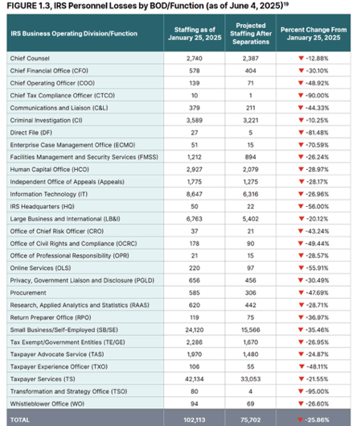

Working With the “Future” IRS
The last 5 years---and future uncertainty =
  Need for a digital first IRS service model

Slide 9


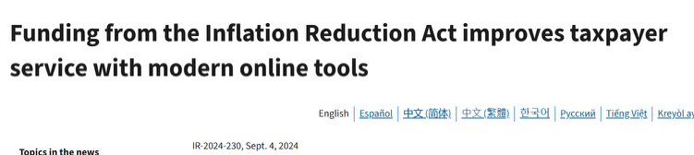
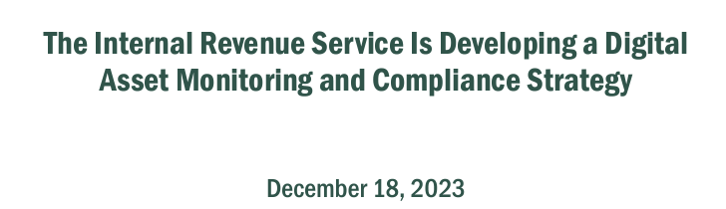
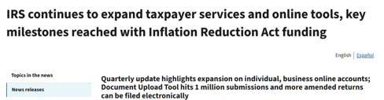
IRS Goes Digital…

Slide 10

Taxpayers and the Digital IRS
Selected IRS.gov Online Tool | 2023 | 2024
IRS.gov visits | 881 million | 690 million
“Where’s my refund?” app | 303 million | 383 million
Online payment agreements | 2.0 million | 2.3 million
“Direct Pay” payments | 12.5 million | 16 million
Online account sessions | 76.1 million | 81.2 million

Slide 11
IRS 2025 Online Service Progress….and Open Issues…
Progress
Focus on adoption of online accounts v. standalone tools
Added features to all types of accounts
Business online account access for entities
Additional transcripts and compliance reports
Open issues
Additional credentialing service provider options
Business online account adoption
Authenticated, real-time interaction with IRS to resolve issues – CHAT!!!
Ability to do common post-filing interactions (penalty abatement, ability to pay collection agreements, change of address, etc.)
Real-time Form 2848/8821 recording on CAF
User-friendly IRS transcripts

Slide 12
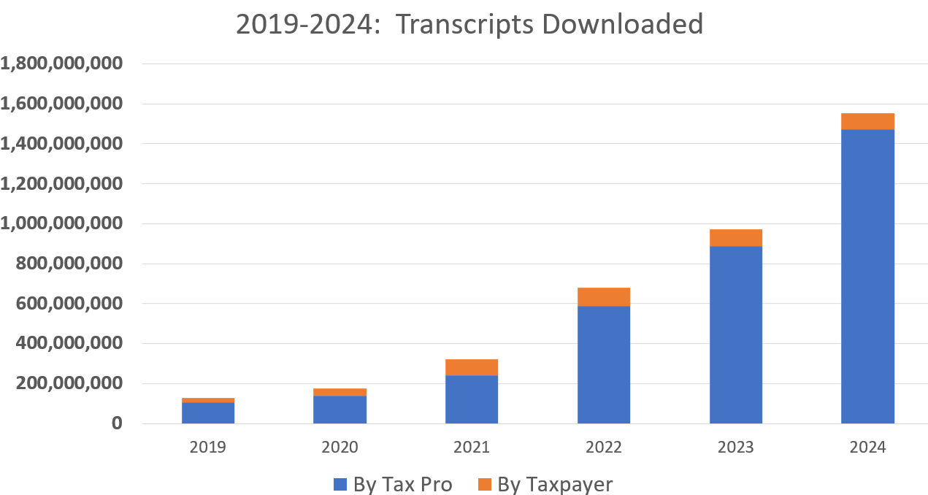
Increase Reliance on IRS Transcripts:
2019-2024 Growth
Why the need for IRS transcripts?
Issues with…
  Can’t get ahold of IRS
  Track return processing and payments
  Refunds and return errors
  Tax compliance problems
  Need account information
Tax Pros: Downloaded over 1.47 BILLION transcripts in 2024

Slide 13
What is the current identity and authentication platform used by the IRS?
IRS “Secure Access”
Login.gov
ID.me
Microsoft Authenticator
Poll Question #1

Slide 14
Working with the IRS
  IRS goes digital
IRS Online Services Update
  Secure Access Digital Identity (SADI)
  IRS Online Accounts
  Other tools for tax pros and taxpayers
  IRS e-Services: SOR and TDS
IRS Transcripts
  Overview
  Best Practices, Tips, and Common uses for transcripts
Proactive Client Support
  Monitoring your client’s IRS activity

Slide 15
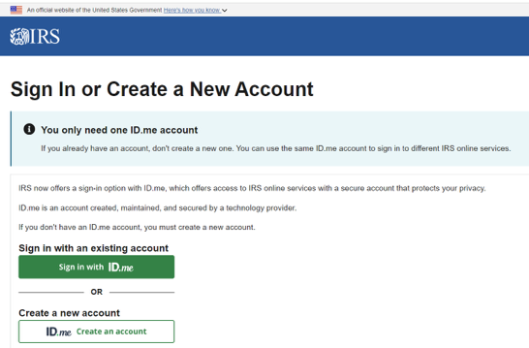
SADI: “Secure Access Digital Identity”
IRS uses third-party for authentication and identity verification for taxpayers and tax professionals
  ID.me
  ID.me is MANDATORY as of May 16, 2023, to gain access to IRS online tools requiring authentication
  Watch for future changes to SADI providers as IRS looks to increase online adoption.

Slide 16
SADI and Access to IRS Online Tools
Taxpayer tools requiring ID.me:
INDIVIDUAL taxpayer online account
BUSINESS taxpayer online account
IRS Secure Messaging
Get an IP PIN
IRS Online Payment Agreement
ID Verification
TIN matching
Tax pro tools requiring ID.me:
E-file application
IRS e-Services programs, including the Transcript Delivery System (TDS)
IRS e-mailbox (Secure Object Repository)
Tax Pro Account
Submit 2848/8821 online
IRS Secure Messaging
Don’t require ID.me: (require one-time authentication with taxpayer filing information)
  “Where’s my refund?” and “Where’s my amended return?”
  “IRS Direct Pay”
No authentication required:
  IRS “Document Upload Tool”
  IRS “Get Transcript” by mail tool

Slide 17
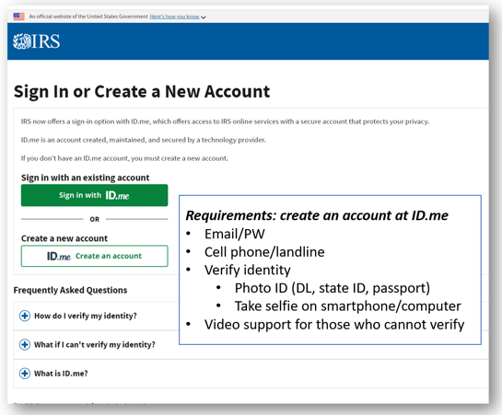
ID.me: Creating an IRS Online Account
Steps to create:
Go to any IRS online tool home page:
  Example: online account: https://www.irs.gov/payments/your-online-account
Select “Create an account”
Register and authenticate using ID.me verification service
Once verified – you have an IRS online account!
Your ID.me login is used for ALL IRS authenticated applications!

Slide 18
What is the most used IRS online tool?
Individual online account
Business online account
Tax pro online account
“Where’s my refund?”
Poll Question #2

Slide 19
Working with the IRS
  IRS goes digital
IRS Online Services Update
  Secure Access Digital Identity (SADI)
  IRS Online Accounts
  Other tools for tax pros and taxpayers
  IRS e-Services: SOR and TDS
IRS Transcripts
  Overview
  Best Practices, Tips, and Common uses for transcripts
Proactive Client Support
  Monitoring your client’s IRS activity

Slide 20
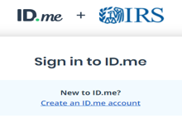
IRS Online Services: Accounts and Digital Tools
Individual online account
Business online account
Tax Pro online account
IRS e-Services
SOR
TDS
E-file application
Standalone online tools
Online tools change often: https://www.irs.gov/help/tools

Slide 21
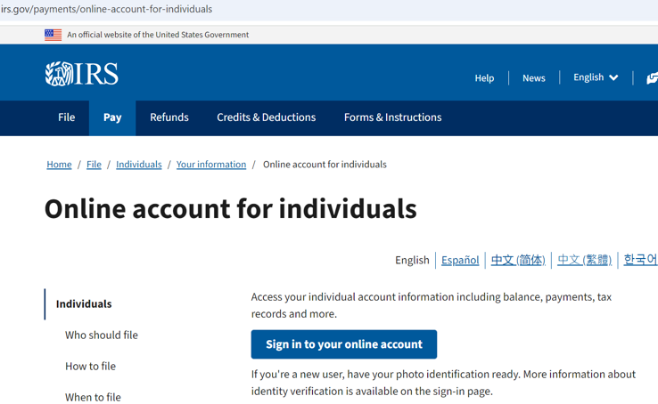
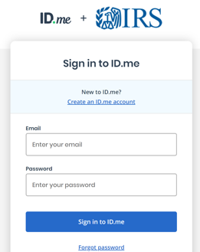
Taxpayer “Your Online Account” - Login

Slide 22
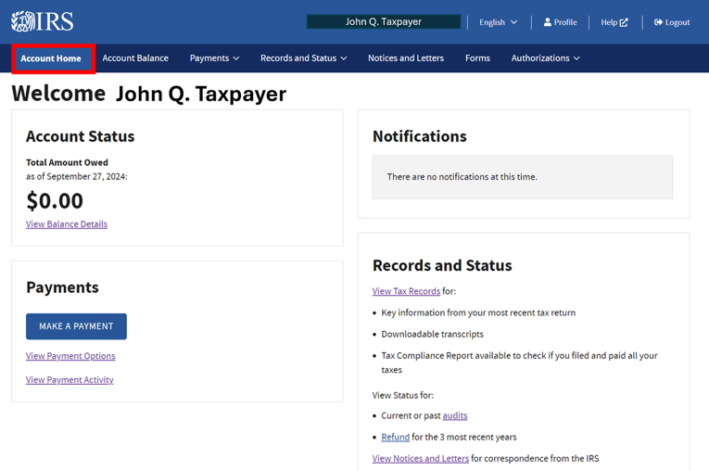
Taxpayer “Your Online Account” Feature: Status
Some taxpayers will be able to “chat” with the IRS through the account
The payoff amount, updated for the current calendar day

Slide 23
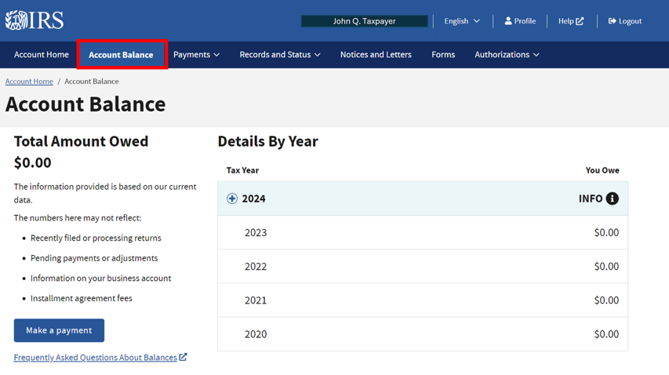
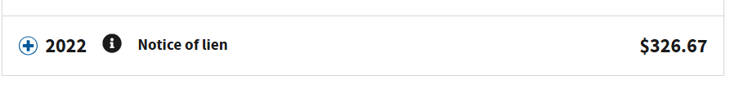

Taxpayer “Your Online Account” Features: Account Balance
The balance owed for each tax year(s)

Slide 24
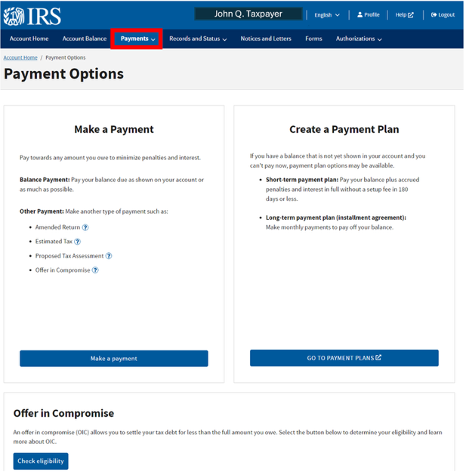
Taxpayer “Your Online Account” Features: Payment Options
Access IRS Online Payment Agreement
Access IRS Direct Pay
Access IRS OIC
Pre-qualifier tool

Slide 25
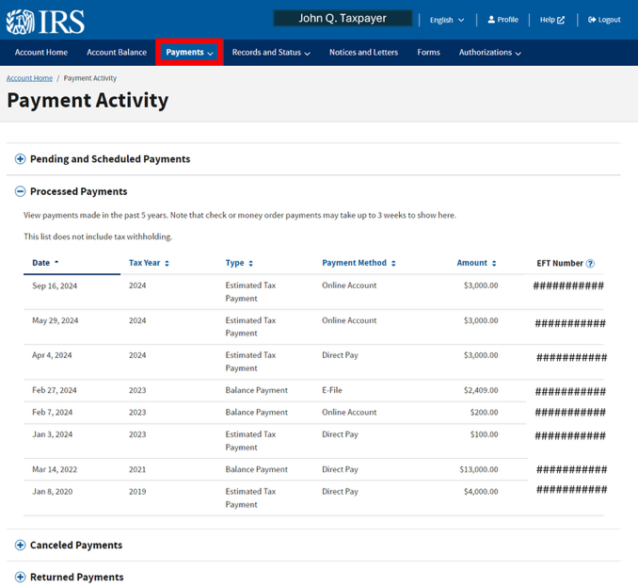
Taxpayer “Your Online Account” Features:
Payment Activity
Payments made in past
5 years

Slide 26
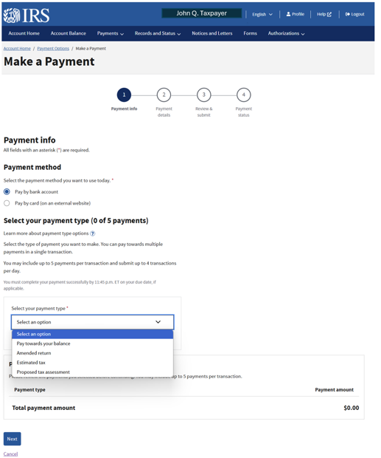
Taxpayer “Your Online Account” Features:
Payment Activity

Slide 27
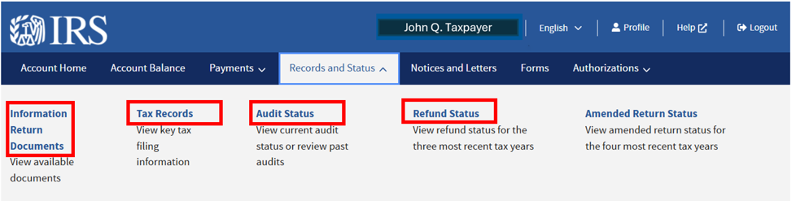
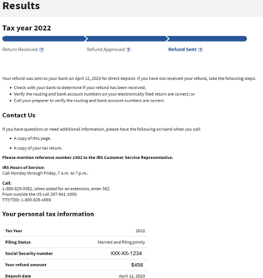
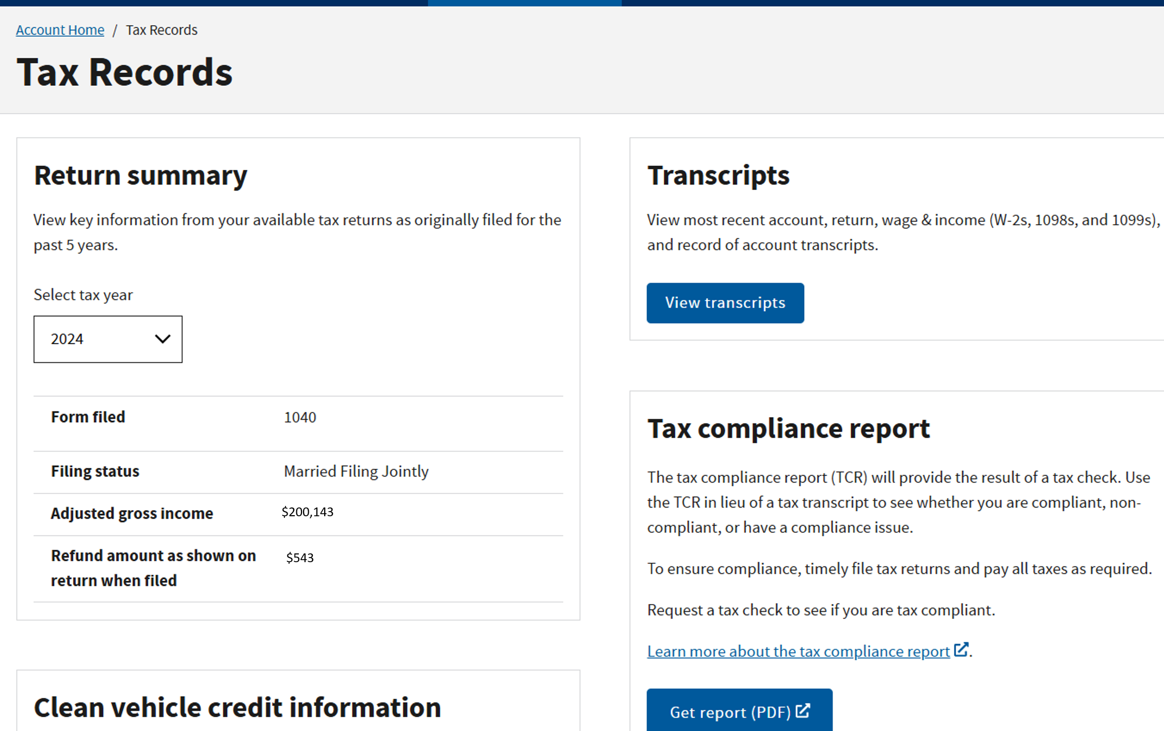
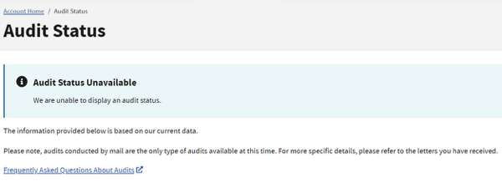
Taxpayer “Your Online Account” Features: Tax Records and Status
Status of open mail audits.
Access to IRS Transcripts & Compliance Report
“Where’s My Refund?” tool

Slide 28
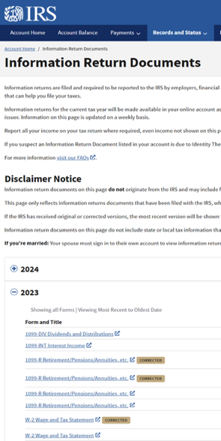
New for 2025: Information Returns
2023 and 2024 tax years
Many IRS forms as they are filed DURING tax season
  Form 1095-A also!
  W-2s
  1099s
Some exclusions
Full list here: https://www.irs.gov/payments/online-account-for-individuals-frequently-asked-questions

Slide 29
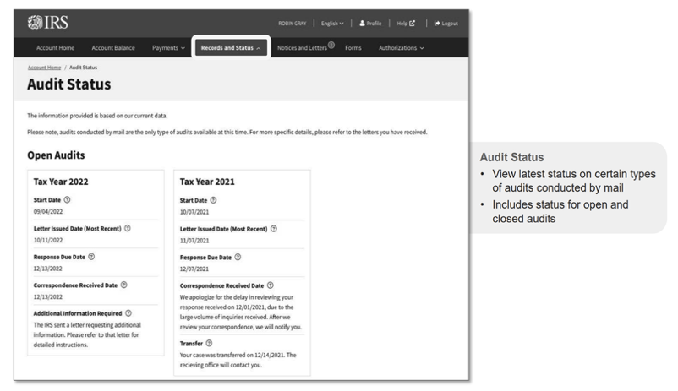
Audit Status

Slide 30
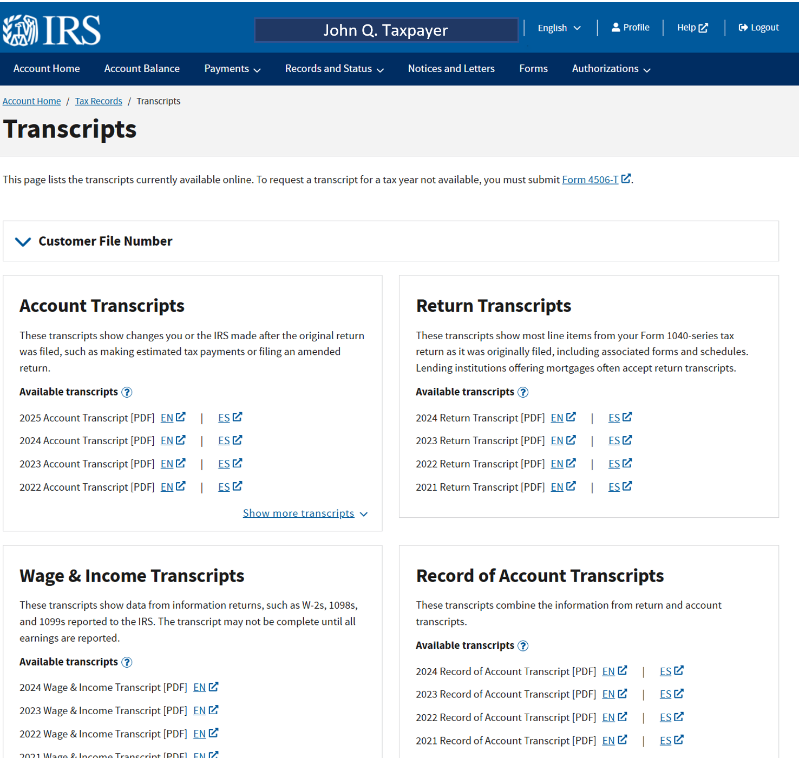
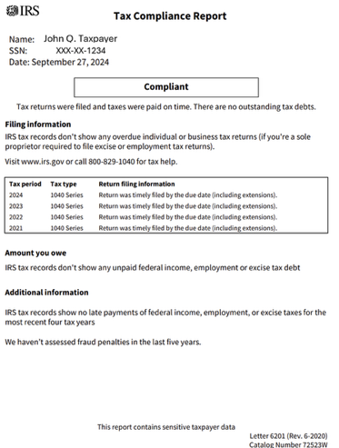
Taxpayer “Your Online Account” Features: Transcripts/Compliance Report
Transcripts:
Return transcript: current and past three years
Record of account: current and past three years
Account: current and past 5 years
Wage/Income: current and past 9 years

Slide 31
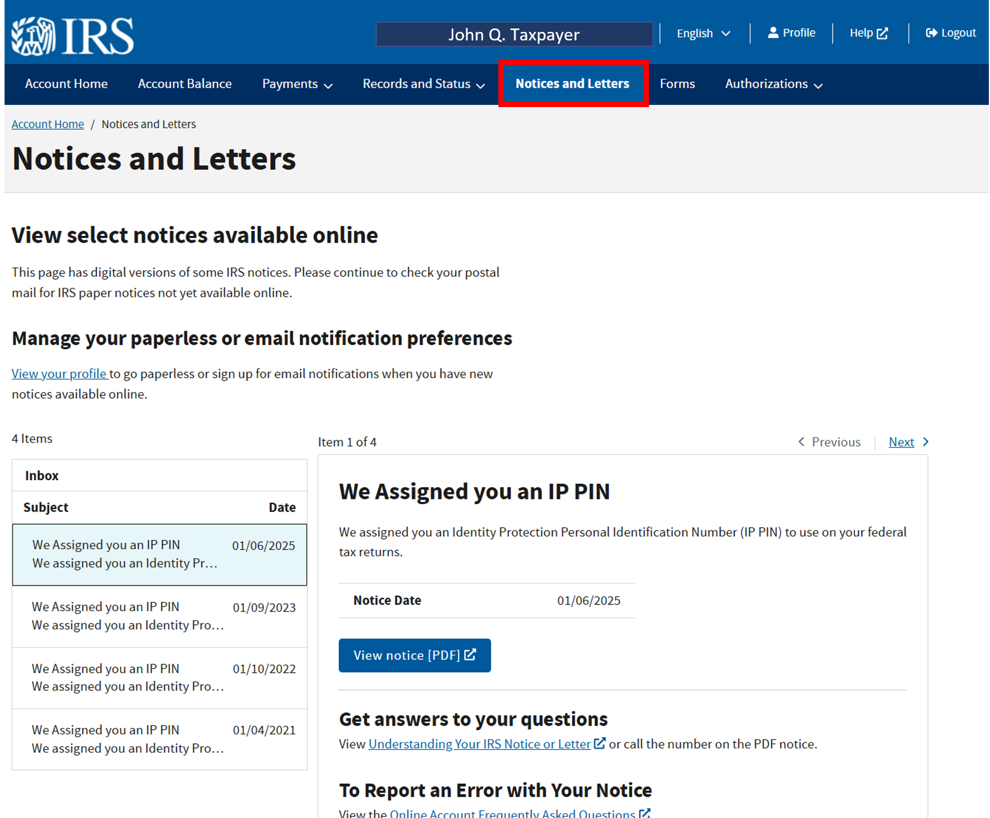
Taxpayer “Your Online Account” Features: Notices/Letters
2025: 270+ Notices
The IRS plans to periodically release more notices to the online account

Slide 32
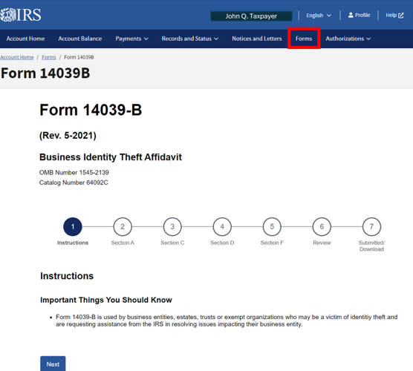
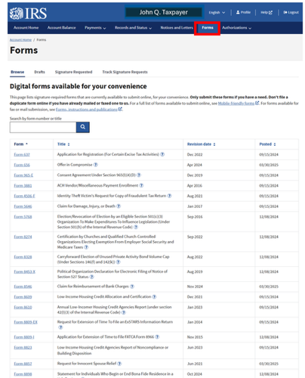
Taxpayer “Your Online Account” Features: Forms

Slide 33
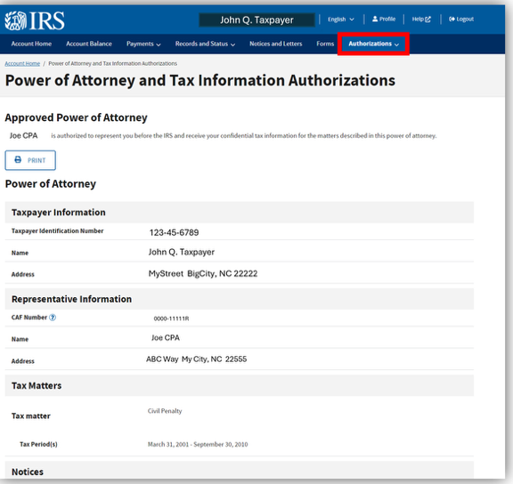
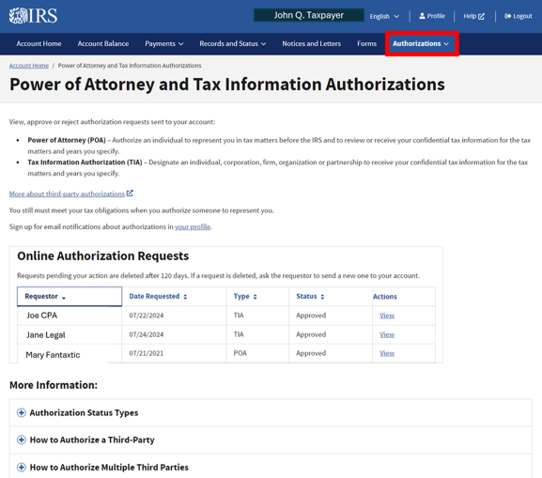
Taxpayer “Your Online Account” Features: Authorizations
Taxpayers can sign a Form 2848 or 8821 online
(cannot revoke)

Slide 34
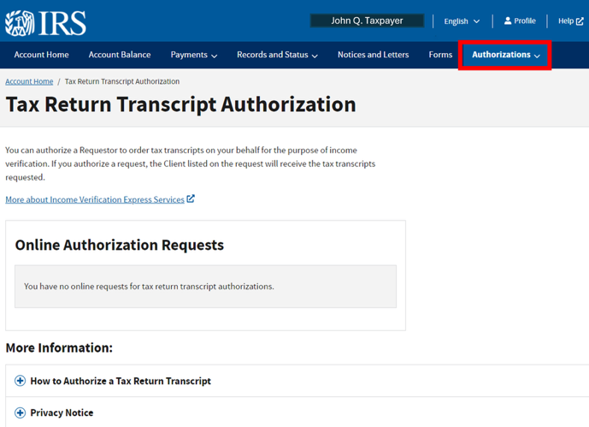
Taxpayer “Your Online Account” Features: IVES Transcript
Authorize an IVES user to get your transcripts
(1X access)

Slide 35
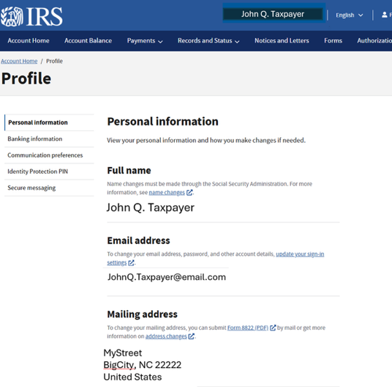
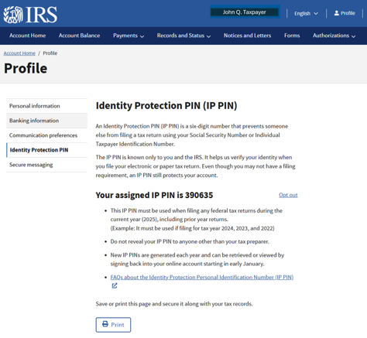
Taxpayer “Your Online Account” Features: Profile
Secure Messaging (?)
Current name and address
Email
Bank account changes
Email notifications
Paperless notices and IP PIN
Coming soon—change of address!

Slide 36
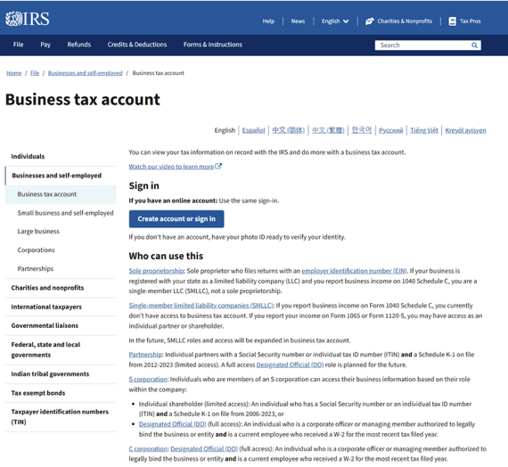
Business Tax Account
Quick facts
Released Fall 2023
Features being added continuously
Access through an individual ID.me login
Access online: https://www.irs.gov/businesses/business-tax-account

Slide 37
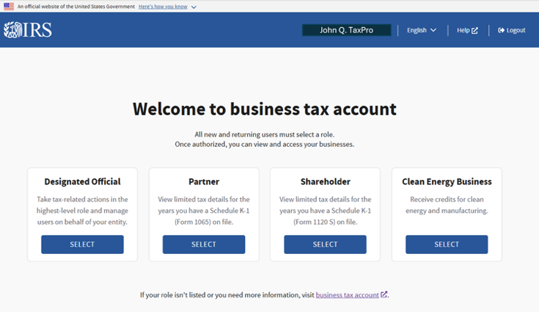
Business Tax Account: Current Capabilities
Who can currently use Business Account:
Schedule C filer with Form 941 filing requirement (not SMLLCs – future addition)
Individual shareholder on 1120S who receives a K-1 (limited access)
Individual partner on 1065 who receives a K-1 (Limited access)
Designated officials:
  S Corporation (officer/W-2 employee)
  C Corporation (officer/W-2 employee)
  Partnership (future)
  Must revalidate each year in June/July

Slide 38
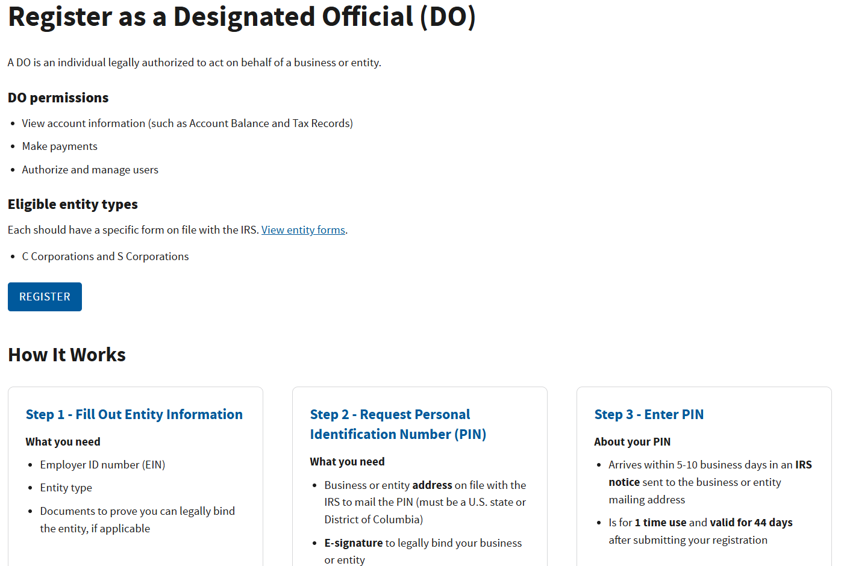
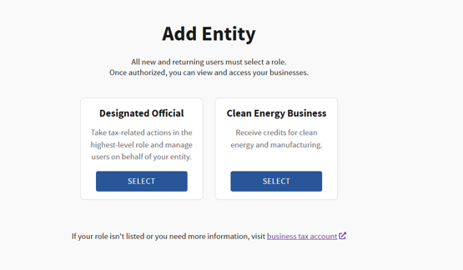
Business Account: Registering the DO
November 4, 2024, Feature: Add Entity and Designate an Official

Slide 39
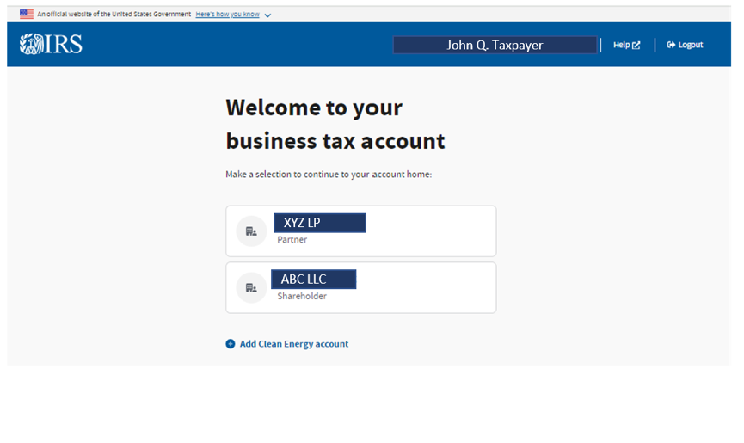
Business Tax Account: Associated Entities
Select an associated entity

Slide 40
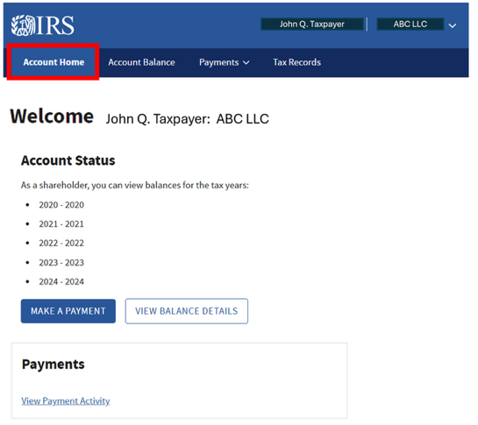
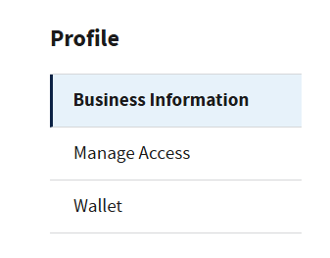
Business Tax Account: Limited Access View Status/Balance/Payments/Profile
Limited access for sole props, 1120S shareholders, and 1065 partners:
Balance, by year
Make a payment on balance due or tax deposits
View payment activity for past 5 years
Profile: entity type/EIN
Designated Officials can:
Manage authorizations and access
Transcripts
Business Compliance Report
View notices/letters

Slide 41
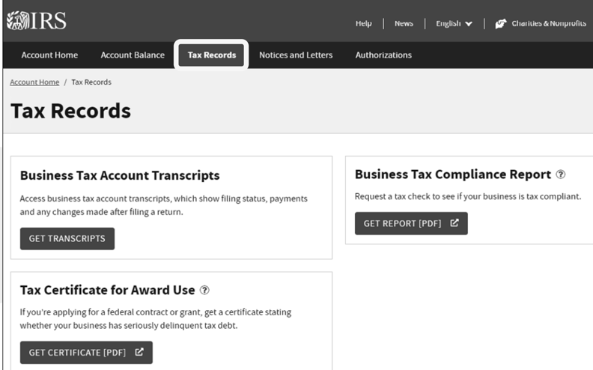
Tax Records: Full View for Designated Officials
Coming soon: more business transcripts
  Business income transcripts
  Return transcripts for 990 series and more 1120 series

Slide 42
How long does it currently take to record a Form 2848 or 8821 with IRS CAF?
Less than 1 week
1-2 weeks
1-2 months
1 day
Poll Question #3

Slide 43
3 Primary Ways to File Your Form 2848/8821 With the IRS
 | Mail/Fax to IRS CAF Unit | Use Submit Form 2848/8821 Online | Tax Pro Account/ Taxpayer Account
Level of difficulty | Easy | Easy | Difficult
Instant access to client info/transcripts? | No: ~1-25 business days to record on CAF (varies greatly) Status: https://www.irs.gov/help/processing-status-for-tax-forms |  | Yes: Can use IRS e-Services TDS immediately
How to record with CAF | West/Miss. River (Ogden): (855) 214-7522 East/Miss. River (Memphis): (855) 214-7519 International (Philadelphia): (855) 772-3156 | At IRS.gov: Use Tax Pro access to “Submit 2848/8821 Online” application Use “e-sign” | At IRS.gov: requires both Tax Pro and Taxpayer Account access and actions

Slide 44
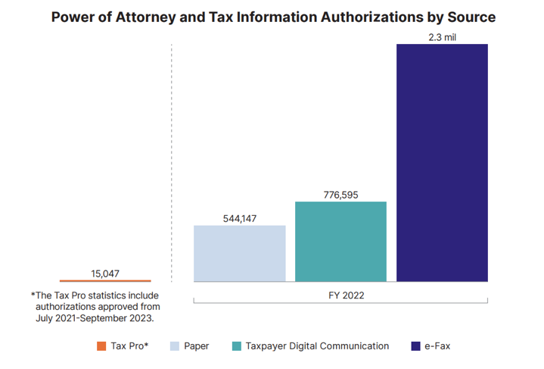
Forms 2848/8821 Submission Methods
Popular: Submit 2848/8821 online
Not so popular: Tax Pro Account/ Taxpayer Account

Slide 45
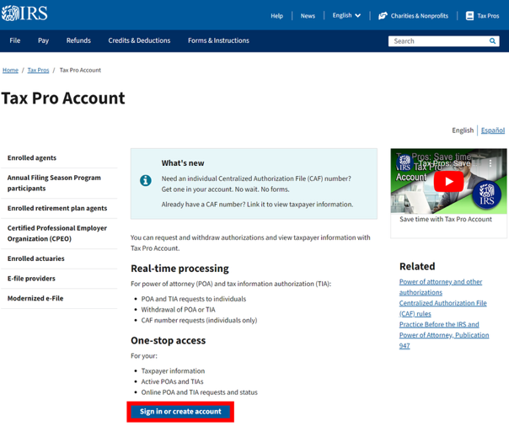

Tax Pro Account
Quick facts:
  ID.me authentication required
  Request 2848/8821 authorization
  Request CAF#
  Link existing CAF#(s)
  Manage authorizations (view and withdraw)
  Client info and interactions: balances, payments, access OPA
  Email notifications
  Access TDS
  Much more to come…
IRS.gov/tax-professionals/tax-pro-account

Slide 46
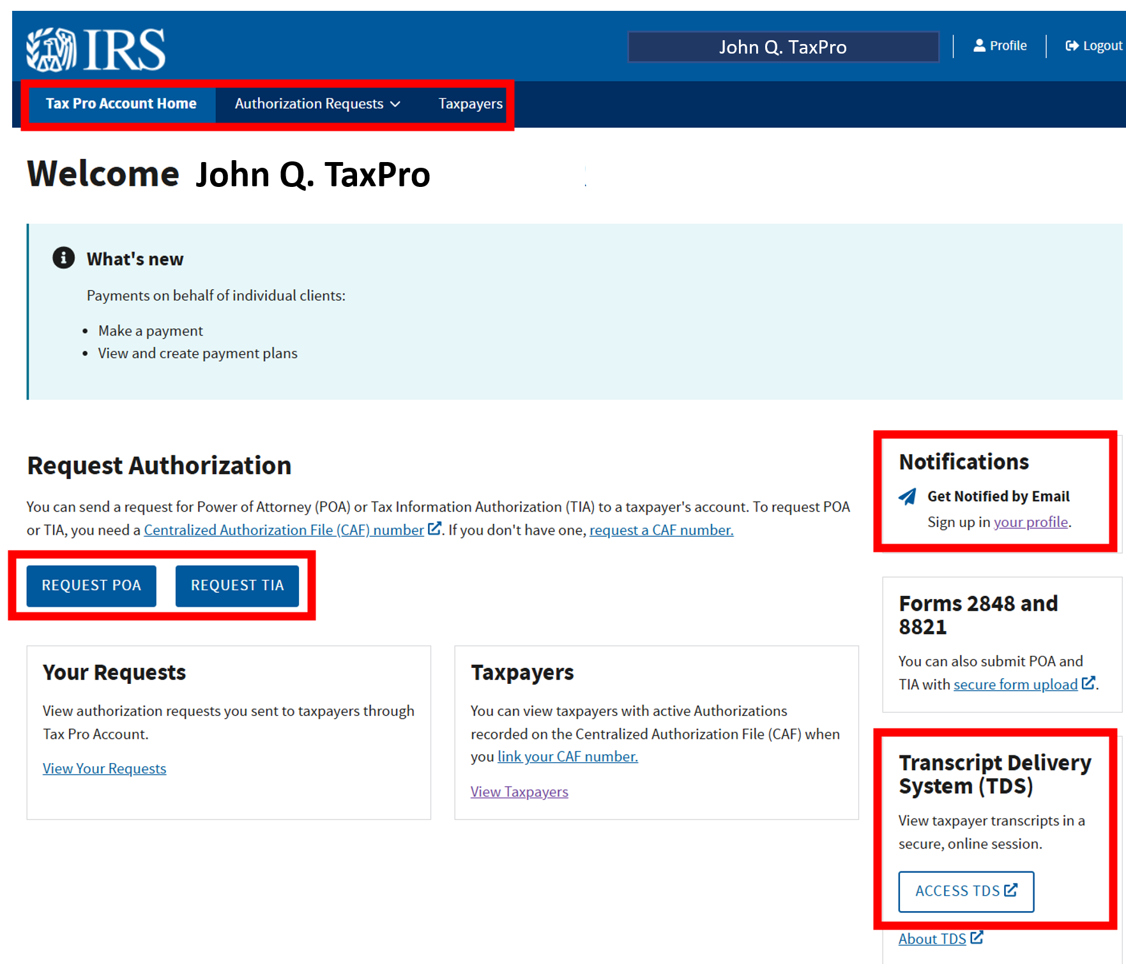
Tax Pro Account: Home
Current features
  Authorization requests and submissions
  CAF management
  Manage clients under authorization
  Quick access to TDS
    Secure Messaging?
  In Progress: chat

Slide 47
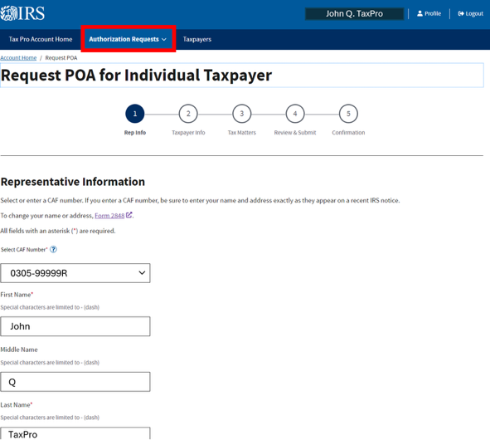
Tax Pro Account: Initiate Power of Attorney
Can request:
  Form 2848 (POA)
  Form 8821 (TIA)
Will pre-fill with your linked CAF #
Form 2848 equivalent

Slide 48
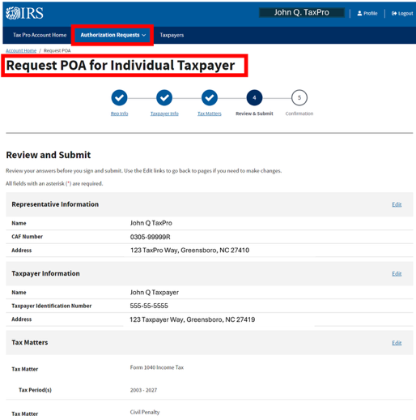
Tax Pro Account: POA Initiated – Important Features
Important
  Be exact with taxpayer info!
  Must let taxpayer know to sign into account/authorize
  Taxpayer must authorize ALL representatives/designees on same day

Slide 49
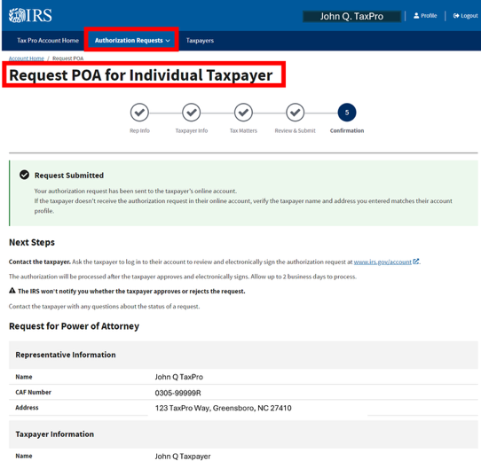
Tax Pro Account: Taxpayer to Authorize
Taxpayer receives the request in their online account
Contact client to sign in their account
Once authorized – instant access to their account!

Slide 50
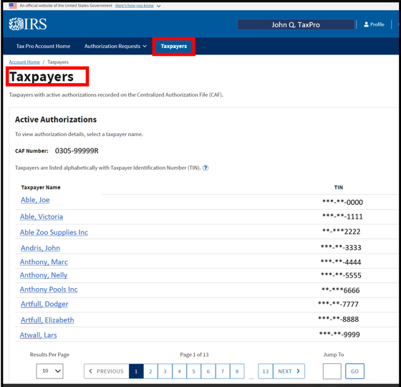
Tax Pro Account: Authorization Management
View all authorizations and status.
Can open authorization, see client balances/payments and withdraw

Slide 51
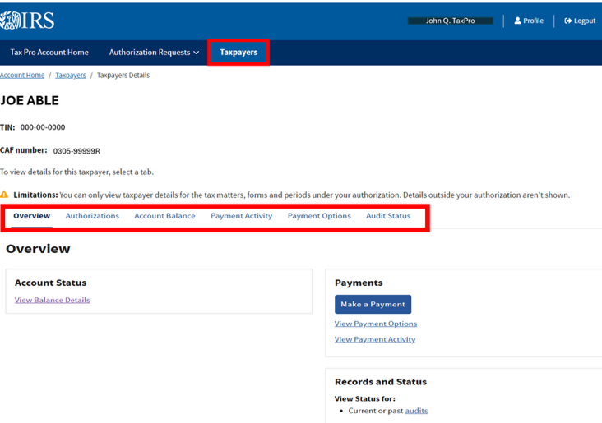
Tax Pro Account: Taxpayer Details
View/use
Account status
Authorizations on file with CAF
Account balance
Payments
Set up payment plan using OPA
Get Audit Status

Slide 52
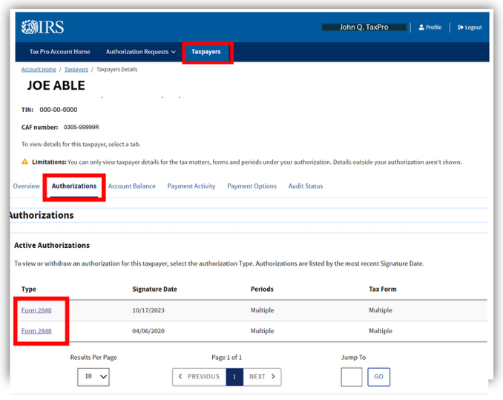
Tax Pro Account: Taxpayer Details – Authorizations
View and open all authorizations on file with CAF

Slide 53
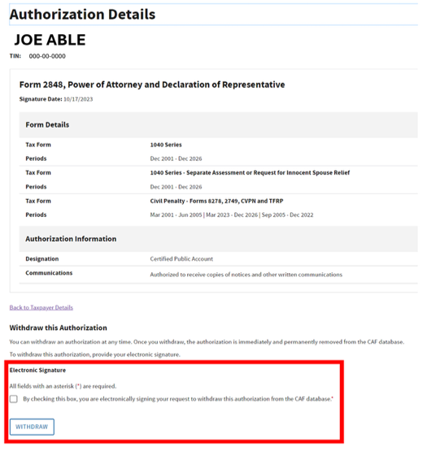
Tax Pro Account: Taxpayer Details –Authorizations
Withdraw an authorization online

Slide 54
Can a tax FIRM obtain an IRS CAF number online?
Yes
No
Poll Question #4

Slide 55


Tax Pro Account: Profile/Obtain a CAF #
Profile:
Email notifications
Request/ Link CAF #

Slide 56

Tax Pro Account: Tax Pro Profile: Link Your Existing CAF#
Link your CAF#
  IRS will send letter with access code in 1-3 weeks
Enter access code to see your authorized clients
Set up email notifications for approved authorizations

Slide 57

Submit Forms 2848 and 8821 Online
https://www.irs.gov/tax-professionals/submit-forms-2848-and-8821-online

Slide 58

Submit 2848/8821 Online: The “Easy” Option
ID.me login and…
  Enter TIN
  Attach signed 2848 or 8821
  Hit “submit”
  Confirmation email
  CAN USE E-SIGN if you have a business relationship with client!!
  Email confirmation

Slide 59
Working with the IRS
  IRS goes digital
IRS Online Services Update
  Secure Access Digital Identity (SADI)
  IRS Online Accounts
  Other tools for tax pros and taxpayers
  IRS e-Services: SOR and TDS
IRS Transcripts
  Overview
  Best Practices, Tips, and Common uses for transcripts
Proactive Client Support
  Monitoring your client’s IRS activity

Slide 60

“Where’s My Refund?” Application
Quick facts:
Most used IRS application
Check current processing year and prior two years
Does NOT require ID.me authentication- only requires:
  SSN/ITIN
  Filing status
  Exact refund amount
Refund delay reasons are not clear – more actions needed (usually a phone call)
Also appears inside the “Individual Online Account”
Access online: https://www.irs.gov/refunds

Slide 61


WMR

Slide 62

WMR Using IRS Account Transcripts
Access account transcript online for status and any other issues on the account…

Slide 63

IRS Direct Pay
Quick facts
Individuals and businesses!
Requires U.S. bank account
Many types of payments allowed
Good for scheduled payments (365 days in advance)
ID.me authentication NOT required
Can make 2 payments in 24-hour period
Individuals: before due date of return, can be used to file an extension!!!
  Select “extension” for reason for payment
Access online at: https://www.irs.gov/payments/direct-pay

Slide 64
Can a tax pro set up a payment plan online for a client?
Yes, an tax pro can
Yes, only licensed tax pros can
No, only taxpayers can
Poll Question #5

Slide 65

IRS Online Payment Agreement (OPA)
Quick facts
2024: 2/3rds of all IRS payment plans are set up using OPA
Over 95% of taxpayers qualify to use OPA
Requires ID.me authentication
Individual short-term and Simple installment agreements
  Short-term (180-day extension to pay) up to $100,000
  Simple IA: pay within collection statute (10 years), up to $50,000 owed (total balance cannot be over $50,000)
Business who less than $25,000
Registered POAs can apply/revise a plan
Access online at: https://www.irs.gov/payments/online-payment-agreement-application

Slide 66
OPA: Lower Fees
Setup fees for payment plans | Direct debit installment agreements (DDIA) | Installment agreement by check/electronic (IRS Direct Pay or EFTPS)
Apply online | $22 | $69
Apply by phone/mail/ in person | $107 | $178
Low income | none | $43 (reimbursed later)
Mail in Form 9465
USE OPA
Extension to pay agreement fees: $0

Slide 67

IRS Secure Messaging
Quick facts:
Standalone tool
  Past and future: in “taxpayer” and “tax pro” online accounts
Used to respond to:
  CP2000 and certain mail audits
  Innocent spouse responses
  Return processing issues with Letter 12C
  Appeals
  Any “invited” access
Can attach files as responses/documentation
Messaging history saved and email notifications!
Must be invited
  Notice with “access code”
Requires ID.me authentication
Access online at: https://www.irs.gov/help/welcome-to-secure-messaging

Slide 68

IRS Secure Messaging: Message History
History of interactions with IRS

Slide 69

IRS Secure Messaging: Resolving Post-Filing Issues
POA use
  POA must be on file
  Taxpayer must have online account and Secure Messaging
  Select issue
  Follow workflow
  Upload response and documents
Access points to submit responses:
  IRS.gov/examreply
  Others…

Slide 70



IRS Chat
Taxpayers and tax Pros can chat with the IRS…
Early development stages
Current use: IRS Collection issues
Good to use to set up a call back for collection

Slide 71
According to the IRS, what % of IRS notices can accept a response online?
24%
44%
64%
94%
Poll Question #6

Slide 72


Respond To “All” Notices ONLINE
IRS “Document Upload Tool” (DUT)
94% of all notices can use this tool to respond:
  No authentication required
  With or without access code on notice
  List notice #, SSN/ITIN, and upload response
  Submit to IRS
  Confirmation page – but no tracking of submission
  Much more coming soon
https://www.irs.gov/help/irs-document-upload-tool
IRS.gov/DUTreply

Slide 73
Working with the IRS
  IRS goes digital
IRS Online Services Update
  Secure Access Digital Identity (SADI)
  IRS Online Accounts
  Other tools for tax pros and taxpayers
  IRS e-Services: SOR and TDS
IRS Transcripts
  Overview
  Best Practices, Tips, and Common uses for transcripts
Proactive Client Support
  Monitoring your client’s IRS activity

Slide 74

IRS E-Services: The Tax Pro’s Toolbox
e-file application
e-Services Mailbox: Secure Object Repository (SOR)
Transcript Delivery System

Slide 75


IRS E-Services: The Tax Pro’s Toolbox
ONLY delivery method to get transcripts from IRS (PPS only)
  “Short ID”
ID.me required
Download transcripts from your “Secure Object Repository”
https://www.irs.gov/e-services

Slide 76

IRS E-Services: Transcript Delivery System (TDS)
Quick facts:
E-file providers (file more than 5 returns electronically) have online access to client transcripts
Must have a Form 2848 or 8821 on file with CAF
Individual representatives and designees have access (Not firms!)
E-file application owner provides firm members access to TDS in their e-file application
Access online at https://www.irs.gov/tax-professionals/transcript-delivery-system-tds

Slide 77

Tax Pro: Get Real-Time Access to Client Transcripts
Step #1: Get an IRS e-Services account on IRS.gov (ID.me)
Step #2: Get access to TDS through an active e-file application (Responsible person for e-file app gives you access)
Step #3: File an authorization for your client with IRS CAF Unit (Form 2848 or 8821) (individual rep/designee only))
Step #4: Access transcripts through IRS e-Services TDS
https://www.irs.gov/tax-professionals/transcript-delivery-system-tds

Slide 78

Enter Delivery Option and Taxpayer Type. Enter CAF #.
Order individual or business transcripts.

Slide 79

Enter Taxpayer Information
Taxpayer information required.

Slide 80
Request Type of Transcript and Tax Forms/ Years
JOETAXPRO
Select type of transcript and purpose
Enter form(s)/year(s)

Slide 81


Download and View Transcripts
Must pass IRS CAF check (confirms your authorization).
Get transcripts. Print or use other tools to print to PDF.
TIP: Use an “ISP” to mass download and analyze IRS transcripts

Slide 82
Working with the IRS
  IRS goes digital
IRS Online Services Update
  Secure Access Digital Identity (SADI)
  IRS Online Accounts
  Other tools for tax pros and taxpayers
  IRS e-Services: SOR and TDS
IRS Transcripts
  Overview
  Best Practices, Tips, and Common uses for transcripts
Proactive Client Support
  Monitoring your client’s IRS activity

Slide 83
The 6 Types of IRS Transcripts
Type | Description | Forms Available | Years Available
Account transcript (“AT”) | Transactions and activity, by year | All forms and separate assessments | All (taxpayers are limited online)
Tax return transcript (“RT”) | Electronic copy of return | 1040, 1065, 1120, 990-T, 1041, 94X series (more coming!) | Current and processed in past three years
Wage/income transcript (“WI”) | W-2s, 1099s, etc., reported to IRS by TIN | 1040 filers online Business: request by phone | Current and past 9 years
Record of account | Combo of AT and RT | 1040, 1065, and 1120 only | Current and past three years
Verification of non-filing letter | Letter stating return not filed | 1040 only | Current and past three years
Business entity transcript (NEW!) | 2 versions: complete and “modified” Provides name, address, and IRS BOD and filing requirements | All business entities | N/A

Slide 84

Accessing IRS Transcripts
Clients
  Form 4506-T
  Online account (limited access)
  Use “Get Transcript” tool on irs.gov to request transcript by mail (account and return only)
Tax pros
  Request from PPS/Compliance unit
  Use IRS e-Services’ Transcript Delivery System (TDS)
  FULL access based on 2848/8821

Slide 85

IRS Account Transcript
Your “IRS account” by year/form
Four sections of information
  Entity section: taxpayer name and address, as filed
  Balance due section: Amounts owed, plus penalty/interest accruals
  Tax return summary section: Key return information
  Transaction section: Activity on the year/form
    Filing indicators
    Payments and credits
    Certain compliance activity and notices
    Account inquiries/requests
Not user-friendly
  Interpreting “what it means” sometimes requires IRS system knowledge

Slide 86


A “Normal” Transcript
A typical “no-issues” account transcript
Common codes:
  150 – tax return filed
  806 – W-2/1099 Withholding
  846 – Refund issued

Slide 87

Return Transcripts
For Forms 1040, 1065, 1120 series
2023 – forward: 94X Series, 990T, 1041
More coming!
Captures info as originally filed (i.e., not amended or changes due after filing)
  Exception: 941s show amended!
Most line items on the return
Usually available 3 weeks after filing
  Exceptions: paper filers and unpaid balance due filers

Slide 88
Can you get your client’s state income tax withholding on a wage and income transcript?
Yes
No
Poll Question #7

Slide 89

IRS Wage and Income Transcripts
For Form 1040 only
Businesses can request their W&I by phone through PPS (COMING SOON to TDS and online accounts)
For the current and previous 9 years
  July version is fully loaded with all info returns
  2025: Released in tax season! March 31, 2025
Very useful for filing back returns and income/asset verification
E-Services TDS: automatically get “unmasked” version
Does not have SITW or healthcare coverage forms (1095 series)

Slide 90


Record of Account Transcript
The record of account transcript is a combination of the account transcript and the return transcript.
Helpful with filing amended returns.

Slide 91

Business Entity Transcript: Work in Progress
2 versions
“Complete” – has filing requirements
“Modified” – has address

Slide 92

Complete Business Entity Transcript
Requires “specific use” Form 2848/8821 to request “business entity transcript”
Specific use authorizations are not recorded on CAF
Use a separate authorization
Contains filing requirements and additional entity information

Slide 93

Start with Transcripts…but Know Their Limits…
Transcripts are limited; PPS provides a complete history
Many notices
Certain transaction codes
Reasons for specific adjustments to a return
Statutes
Status and pending transactions
Refund freeze causes
Deadlines
Many enforcement actions
Accurate payoff amounts
Notes:
ONE BIG WARNING TO YOU: Account transcripts may not present the entire picture- here is a picture of the IRS’ screen- all of their information is not given to the taxpayer on their transcripts-
For example, many notices do not appear on the account transcript- also, the reasons for adjustments do not show up – many penalty abatement letter requests do not show up – if your client’s refund is frozen, you do not know why...
Here is an IRS insider tip: the IRS uses TC 290 and 971 as “catch alls” – 290 usually indicates something is wrong, changed, or being questioned about the accuracy of a return. TC 971 is a catch all that indicates other activity- usually related to underpayment of taxes or penalties – on the account –
The morale of the story- if you get any out of the ordinary TCs on a transcript, you should probably call the IRS and get a complete tax history and specific answers on activity.

Slide 94

Tax Pros Access to Account Information by Phone
Use with the “Practitioner Priority Service” hotline
“PPS”:
  1-866-860-4259
  Open: M-F, 7A-7P (local time)
  Trained to solve account issues
  5 clients per call
  Provide transcripts into secure e-services mailbox (30 transcript limit)
  Can make account adjustments if not in compliance enforcement
  Route you to Collection, Mail Audit, or CP2000 functions
  Can fax authorization (2848/8821) if not on file
  Call early to avoid wait times

Slide 95

IRS E-Services Mailbox
Access your e-Services account
Download transcripts from your “Secure Object Repository”
https://www.irs.gov/e-services

Slide 96
Working with the IRS
  IRS goes digital
IRS Online Services Update
  Secure Access Digital Identity (SADI)
  IRS Online Accounts
  Other tools for tax pros and taxpayers
  IRS e-Services: SOR and TDS
IRS Transcripts
  Overview
  Best Practices, Tips, and Common uses for transcripts
Proactive Client Support
  Monitoring your client’s IRS activity

Slide 97

10 Practical Uses for Client Transcripts
Many uses, including……
  Obtain a new client tax history
  Confirm your client is in “good standing”
  Account confirmations and filing assistance (payments, filing, extensions, etc.)
  File an amended return
  Evaluate quick penalty abatement relief
  Avoid mismatch notices (CP2000s)
  Pre-fill current year return and file a prior year return
  Stage an extension filer
  Detect tax identity theft
  Prepare for an audit

Slide 98
Obtain a New Client Tax History With IRS Transcripts
Relieve your client of the “document download”
Get the tax info straight from the “source”
Review the history for:
  Client profile, income sources, and deduction/credit history
  Payments, extensions, offsets
  Potential return errors and amended return opportunities
  Unfiled past returns
  Post-filing issues that need to be reconsidered
  Balances owed
  Quick penalty abatement opportunities
  Much more….
Get your client’s tax history:
Return transcript: past three years (provides return information)
Wage and income: past three years (primary and spouse, if needed)
Account transcript: current year and 6 years prior
Example: 2025 tax year client – get:
Return transcript: 2022-2024
Wage and income: 2022-2024 (2025 on March 31, 2026!)
Account transcript: 2019-2025

Slide 99

Confirmations and Filing Assistance: Important Account Information
Avoid math error and discrepancy notices
  Use an Account transcript to confirm:
    Extension filed
    Payments
    Filing confirmation

Slide 100
What % of taxpayers do not take advantage of IRS first-time penalty abatement?
20%
40%
60%
80%
Poll Question #8

Slide 101

Review IRS Account Transcripts for Quick First-Time Abatement (FTA)
Taxpayer | Individual, business, payroll (no estate or gift)
Penalty | FTF, FTP, FTD (not accuracy or estimated tax penalty)
Compliance History | No FTF, FTP, FTD, or accuracy penalties for the past three periods before penalty year (estimated tax penalty does not disqualify) Up-to-date on payments if owe the IRS
Filing History | All required returns filed (past 3 years)
Amount | No limitation
Abatement | First period penalties only
Time to request | Within the refund statute expiration date (3 years from due date or 2 years after tax is paid)
First year failure to file and pay penalties qualify for FTA (Employers – deposit penalty too!
If you do not take the FTA, you lose it….
All FTA requests can be made by phone.
2026 Update: FTA is now applied automatically by the IRS

Slide 102

IRS Account Transcript Analysis: FTA
Steps:
  Obtain past 3 years account transcripts prior to penalty year
  Review prior three years for disqualifying penalties
  Determine returns are filed
  Determine if FTA applies
  Request FTA by phone

Slide 103

Account Transcripts FTA Analysis
Individual clients: review three years prior to penalty in question for these transaction codes:
TC | Description | Why?
150 | Tax return filed & liability assessed (date return was processed) | Confirm return filed
160/166 | Failure to file penalty | These penalties, if significant, will disqualify your client
270/276 | Penalty for late payment
240 | Misc. penalty: IRC 6662 accuracy
170/176 | Estimated tax penalty | This penalty does not disqualify your client from FTA

Slide 104
Preventing the Income Mismatch (CP2000)
Six client profiles that often have mismatches
Clients with many 1099-Bs (stock transactions)
1
    Avoid a CP2000
      File an extension for your client’s return
      Use W&I transcript for current year (avail. In March!– full version in July).
      Match W&I transcript to your client’s records to accurately report income and expenses.
Clients who have moved during the year
2
Clients with incomplete or missing records
3
Clients who file delinquent returns
4
Clients with a history of tax filing errors
5
Clients new to your firm/practice
6

Slide 105


Filing a Current Year or Prior Year Return
Current year: use initial version of W&I transcript released in March
  Check Account transcripts for estimated payments
Late filed returns: conduct IRS screening with W&I transcript analysis
  Account transcripts provide indicator of IRS non-filer enforcement
    CP59 issuance
    Substitute for return filing

Slide 106


Simplifying the Extension Filing Experience
Set you/client up for success:
  Get the extension.
  Ask for a Form 8821 (2/8821s for MFJ).
  Pull their account and wage/income transcripts in June.
  Pre-fill return with income and account information.
        Forms W-2/1099, others
        Estimated tax payments and other applied credits
Streamlines the process!
Improves return accuracy: avoid underreporting and missed deductions.
Reduces client workload.
Identifies prior issues with IRS.
Shows your expertise.

Slide 107

Employment Related Tax Identity Theft
Did someone steal your client’s identity for employment purposes?
Review your client’s wage and income transcripts.

Slide 108

Identity Theft? Account Transcripts
Is there compliance activity on your client’s account?
Is there a request for an unfiled return even though your client doesn’t have a filing requirement?
TC | Description
140 | Inquiry for nonfiling of tax return
922 | Underreporter inquiry
290 | Additional tax assessed
971 | Account related notice issued (with CP #)
420/424 | Examination of tax return

Slide 109
Working with the IRS
  IRS goes digital
IRS Online Services Update
  Secure Access Digital Identity (SADI)
  IRS Online Accounts
  Other tools for tax pros and taxpayers
  IRS e-Services: SOR and TDS
IRS Transcripts
  Overview
  Best Practices, Tips, and Common uses for transcripts
Proactive Client Support
  Real- time access to client IRS transcripts

Slide 110
Post-Filing Assistance
>40% of your clients will need to work with the IRS after filing
One-third will have
a tax problem
Two-thirds will need you to answer
a question about their IRS notice, account or status
How can we in a position to help?

Slide 111
Get Real-time Access to Your Client’s IRS Activity
24/7 access to your clients’ IRS information:
Proactive: get notifications of an IRS notice
Prepared: ability to access client information immediately from the IRS
Efficient: avoid unnecessary phone calls to the IRS
Offer a new service for your clients: IRS monitoring
Three steps to monitor your client’s IRS activity:
  #1: Get a Form 8821, Tax Information Authorization
  #2: File it with IRS CAF
  #3: Monitor notices/client IRS account
Use an Intermediate Service Provider program to mass download and analyze transcripts for changes and issues.

Slide 112

Changes Coming…
IRS digital tools and account information changes:
Taxpayer online account capabilities
Tax pro-online account capabilities
Business online account access
E-sign capabilities of Forms 2848/8821
More types of IRS transcripts!

Slide 113

Reference Guide. Need More Help?
Reference guide for
  Essentials of IRS Practice
  Step-by-step instructions to resolve most common problems
  Template letters and worksheets
  Practical examples
  IRS contact resources
  Transcript assistance
  Common IRS notices and post-filing forms
Free Resource at: TaxProblemsHandbook.com

Slide 114
Appendix
Helpful resources:
  Top 10 IRS Online Resources (1 slide)
  IRS Direct Pay Workflow (4 slides)
  IRS OPA Workflow (4 slides)
  4-steps to obtain TDS access in IRS e-Services (4 slides)
  Masked v. Unmasked Transcripts (1 slide)
  Transcript Use Case: Confirm Client is in Good Standing with IRS (1 slide)
  Transcript Use Case: Filing an Amended Return (3 slides)
  Transcript Use Case: Preparing for an Office/Field Audit (4 slides)

Slide 115
A: 10 Most Used “Taxpayer” Online Tools Summary
Online Tool (Link) * = ID.me authentication required | Purpose
*Your online account https://www.irs.gov/payments/your-online-account | Individual taxpayers: obtain tax account information/interact with IRS
*Business tax account https://www.irs.gov/businesses/business-tax-account | Sole prop with EIN, S-corp. S/H, partnership partners taxpayers: obtain tax account information/ interact with IRS
Get Your Tax Record (get transcript) https://www.irs.gov/individuals/get-transcript | Obtain IRS transcripts (can request to last 3 years’ return and account transcripts by mail)
*Get an Identity Protection PIN (IP PIN) https://www.irs.gov/identity-theft-fraud-scams/get-an-identity-protection-pin | Request an IP PIN to protect from refund fraud or retrieve an IP PIN to file electronically
*Identity Verification Service https://www.irs.gov/identity-theft-fraud-scams/identity-and-tax-return-verification-service | Verify identity online to release a tax return refund after receiving IRS Letter 5071C/5747C/6331C/5447C
Where’s My Refund? https://www.irs.gov/refunds | Check on status and delivery of refund
IRS Direct Pay https://www.irs.gov/payments/direct-pay | Make a payment through ACH debit from a bank account for 1040/related individual account payments
Where’s My Amended Return? https://www.irs.gov/filing/wheres-my-amended-return | Check on status and acceptance of amended return for current and three prior tax years
*Online Payment Agreement https://www.irs.gov/payments/online-payment-agreement-application | Set up a payment plan, extension to pay, or change an existing plan
IRS Document Upload Tool https://www.irs.gov/help/irs-document-upload-tool | Upload a response to an IRS notice or letter directly to the IRS

Slide 116



B: IRS Direct Pay: Directing the Payment
Applying the payment
Reason for payment:
  Estimated tax
  Balance due
  Payment plan
  Audit/CP2000 assessment
  Many more…
Apply payment to:
  1040
  1040 SRP
  Form 5329 tax
Year: current and last 18-19 years

Slide 117

IRS Direct Pay: Verifying Identity
ID Verification does not require ID.me
Verify info to a tax year (past 5-6 tax years, depending on time of year)
  Filing status
  Name
  SSN/ITIN
  DOB
  Address
Cannot use Direct Pay if you never filed a tax return

Slide 118

IRS Direct Pay: Making a Payment
Enter
  Payment amount
  Payment date (can schedule future payments)
  Bank information
  Email
  Sign electronically

Slide 119


IRS Direct Pay: Payment Confirmation
Payment is confirmed
  Online confirmation
  Email confirmation
Confirmation # can be used to look up payment and/or cancel payment
Payment clears in 24-48 hours
Payment will show up in the online account next day after payment

Slide 120

C: OPA: Using Form 2848 (Licensed Tax Pro)
Must be a Circular 230 provider
  Enrolled agent
  CPA
  Attorney
Authorization on file with IRS CAF Unit
POA inputs:
  CAF#
  Date Form 2848 signed
Completes OPA for client

Slide 121

OPA: Balance Due Information
Details on balance due
  Year(s)
  Assessed balance
  Accrued penalties and interest
  Total balance
Option to pay in full or select payment plan

Slide 122

OPA: Select Payment Terms
Payoff information available!
“Estimated” costs
Payment options
  Full pay
  90-days
  180 days (short-term payment agreement)
  Simple installment agreement
  (Pay before Collection Statute Expiration Date)

Slide 123

OPA: Complete Application
Put in monthly payment amount
  OPA will check to see if it meets minimum payment requirements
  Minimum payment will be provided if proposed payment is not sufficient
  Select how to pay
  RECOMMEND DDIA!

Slide 124


D: Step #1: How to Get IRS E-Services TDS
Step #1: Get an e-Services account on IRS.gov (ID.me)
https://www.irs.gov/tax-professionals/transcript-delivery-system-tds

Slide 125


Step #2: How to Get IRS E-Services TDS
Step #2: Get access to TDS through an active e-file application
(E-file Application Responsible Official enables access in this step)

Slide 126


Step #3: How to Get Access to TDS
Step #3:
File your “individual” authorization (2848/8821) and have it recorded on CAF
1
Form 2848,
Power of Attorney
2
Form 8821,
Tax Information Authorization

Slide 127

Step #4: How to Get Access to TDS
Step #4: 2848/8821 on CAF: Login to IRS e-Services TDS

Slide 128

E: “Masked” v. “Unmasked” Transcripts
Sept. 2018: IRS begins “redacting” PII on transcripts (“masked transcripts”)
June 2019: IRS stops “faxing” transcripts
Tax pros: able to get “unmasked” transcripts
  IRS PPS: can request any type of unmasked transcript to be sent to SOR
  e-Services: will download “unmasked” W&I transcripts
Taxpayers cannot get their “unmasked” transcripts online
  Can get unmasked W&I by mail

Slide 129
F:Confirm You Client Is in “Good Standing” With the IRS
The “good standing” checklist, using transcripts:
Filing compliance
  Account transcripts: past 6 years for “filing” confirmation
Payment compliance
  Account transcripts: review past history (can go back many years if needed)
  Online account review: any balances owed
  Account transcript: current year’s estimated taxes paid
Filing accuracy
  Return transcript/wage and income transcript: review last three years to make sure client reported all income
  Account transcript: prior CP2000s and audit activity
IRS notices and compliance activity
  Account transcripts for past 6 years: review for notices issued, audit or collection activity, and other issues – like identity theft.
Penalty relief: review past account transcripts for FTA

Slide 130


G: Filing a Correct Amended Return

Slide 131

Record of Account transcript: Use to File an Accurate Amended Return
Prior to filing an amended return, order a “record of account”
Return transcript section provides a copy of the return as originally processed
Account transcript section shows any adjustments to the return
Unaware of adjustment reason? Call PPS

Slide 132

Amended Returns: Account Transcript Section
Due diligence:
  Review account transcript for adjusted return:
  Prior amended returns
  TC 150 amounts match filed return and “info from the return” section (review return transcript section)
  TCs and amounts that indicate changes to the return
  TCs indicating current notices that challenge accuracy of return
Transaction Code (TC) | Description
290/291 | Additional tax assessed/abated
300/301 | Additional tax assessed/abated from an audit
150 | Tax per return
971 | Notice issued
977 | Amended return filed and posted
420/424 | Audit indicator
922 | Underreporter inquiry

Slide 133
H: Preparing for an Office or Field Audit
    Order past three years transcripts:
      Return transcripts: complete three-year return comparison for significant fluctuations in income and expenses.
      Account transcripts: review for past notices, audit results, and other areas of non-compliance. (may want to go back to earlier years!)
      Wage and income transcripts: review specific sources of income and expenses and match them to the return.
      Summarize: your findings before the audit to illustrate your client’s compliance to the agent.

Slide 134


Audit Prep: Do a Wage and Income Verification
Match income on return with income reported to IRS
  Obtain W&I information from IRS (SSN and EIN!).
  Match to return.
  Explain discrepancies.

Slide 135

Audit Prep: Do a Three-year Return Comparison
Item | Year 1 | Exam year | Year 3
Receipts | $966,000 | $520,000 | $780,000
Cost of goods | $500,000 | $500,000 | $500,000
Interest expense | $100,000 | $200,000 | $100,000
Salaries | $0 | $100,000 | $0
Other | $200,000 | $100,000 | $50,000
Net income | $150,000 | ($400,000) | $100,000
Be prepared to explain significant variances.

Slide 136

Audit Prep: Identify Employers, Customers and Financial Accounts
Item | Amount | Reported? | Were
W-2: Enorma Corp | $200,0000 | Yes | 1040, Line 7
W-2: Huge Corp | $100,000 | Yes | 1040, Line 7
1099-MISC: NEC Side Job | $30,000 | Yes | Sch C, line 1
1099-B: Great Stock | $425,000 | Yes | Sch D, 8949
1098: Home Bank | $44,000 | Yes | Sch A, line 10
1098: Rent Bank | $24,000 | Yes | Sch E, line 12
Are these amounts accounted for on your client’s return(s)?

